Slide 1
Lecture 13: Automated Test Case Generation
Gregory Gay
DIT 635 - February 26, 2021

Slide 2

Automating Test Creation
Testing is invaluable, but expensive.
We test for *many* purposes.
Near-infinite number of possible tests we could try.
Hard to achieve meaningful volume.
Notes:
We must produce reliable, robust software. Testing is invaluable in that quest. The downside, of course, is that testing is also very expensive especially since we test for *many* purposes, validating correctness, assessing performance, looking for security vulnerabilities, memory leaks, excessive battery usage, and so on. Any real-world piece of software with value has (3-4).

Slide 3

Automation of Test Creation
Relieve cost by automating test creation.
Repetitive tasks that do not need human attention.
Generate test input.
Need to add assertions.
Or just look for crashes.
Automation!
Tests are generating!
Notes:
However, we live in the age of automation - of AI, of big data and deep learning, and all of that. Can’t we do something about this? This cost, the remendous amount of manual, fallable human effort going into testing, could be relieved by automating part, at least, of the creation process. Now, we don’t *yet* have magic AI yet where we can press a button, go have fika, and come back to tested software. But, there are practical, usable means of automating parts of testing. We can look for (2), and see what we can do about those. For instance, our focus todat is on how we can automate input generation. WE can Have a program come up with ways to poke and prod the system and see what happens. This DOES not take care of the oracle I mentioned. You get input, but no expectations on output. So, you can use automation in two ways here. The first is that you can generate input and have a human add assertions, still some human effort but can still save you time - especially if you have a good set of general assertions describing properties of correct output. Or, in many cases, we just want to see crashes or exceptions - then we don’t need human help at all - fuzzers, for instance, can very effectively find crashes, overflows, and other security vulnerabilities without human intervention.

Slide 4
Today’s Goals
Introduce Search-Based Test Generation
(AKA: Fuzzing)
Test Creation as a Search Problem
Metaheuristic Search
Fitness Functions
Example - Generating Covering Arrays for Combinatorial Interaction Testing

Slide 5
Test Creation as a Search Problem
Do you have a goal in mind when testing?
Make the program crash, achieve code coverage, cover all 2-way interactions, …
You are searching for a test suite that achieves that goal.
Algorithm samples possible test input to find those tests.
Notes:
Let’s reformulate how we think of testing a little. The common thread is that we have a purpose in testing, some kind of goal in mind (2, whatever we want to do when we create tests)
(3) Out of the massive space of input, we want any one that gives us what we are searching for. The smallest covering array of 2-way interactions, tests that achieve 100% statement coverage, tests that detect a set of seeded faults, etc.
Is that goal measurable? Then we’re in good shape. If you have a goal, and if that - if we can judge whether or not we’ve achieved that goal, then you have a search problem. Out of the near-infinite set of inputs, I would like a set of inputs that meets that goal. Then, we can have an algorithm sample test inputs from the space of all possible input in an attempt to optimize that goals.

Slide 6
Test Creation as a Search Problem
“I want to find all faults” cannot be measured.
However, a lot of testing goals can be.
Check whether properties satisfied (boolean)
Measure code coverage (%)
Count the number of crashes or exceptions thrown (#)
If goal can be measured, search can be automated.
Notes:
The ultimate goal of testing, to find all faults, is not something we can check for attainment of. We don’t know what faults exist. WE can’t know what faults exist. However ,we’ve invented all of these practices and measurements as approximations of the idea of fault-finding effectiveness - if you do these things, you will probably find faults - and the vast majority of those can be measured in one of three ways. Many in yes/no checks (3), others we can even watch the progress of and check partial completeness (4). Yet others we can count and say that higher counts are better, even if we don’t know the ceiling (5) As it turns out, computers are very good at these kind of search problems. If we can take a candidate solution and check whether it meets our goal, then computers can search for a solution, and there are many techniques we can use.

Slide 7

Search-Based Test Generation
Make one or more guesses.
Generate one or more individual test cases or full suites.
Check whether goal is met.
Score each guess.
Try until time runs out.
Alter the population based on strategy and try again!
Notes:
The rough idea of a search process is that you (1-2). (3) Score each solution based on their attainment of the overall goals. Then (5) Alter the population of guesses based on our search stragegy- our heuristic and potentially feedback from those scores - and try again.

Slide 8
Search Strategy
The order that solutions are tried is the key to efficiently finding a solution.
A search follows some defined strategy.
Called a “heuristic”.
Heuristics are used to choose solutions and to ignore solutions known to be unviable.
Smarter than pure random guessing!
Notes:
(1). We generally have a near-infinite set of possible options. We can’t try them all, and we want to spend the shortest time we can to find a solution that meets our goals. As a result, all search techniques follow a defined strategy
If other solutions share properties with candidates already tried that rule them out as candidates, you can choose to ignore them in favor of other candidates. Metaheuristics determine the order that we explore the search space. (last point)

Slide 9
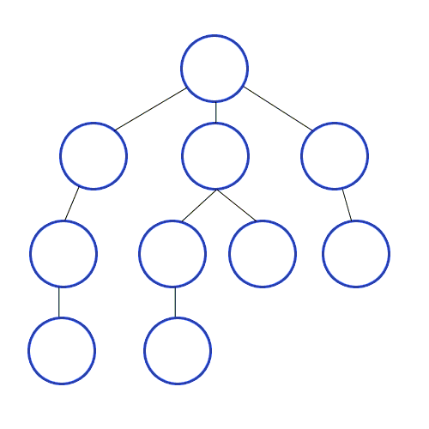
Heuristics - Graph Search
Arrange nodes into a hierarchy.
Breadth-first search looks at all nodes on the same level.
Depth-first search drops down hierarchy until backtracking must occur.
Attempt to estimate shortest path.
A* search examines distance traveled and estimates optimal next step.
Requires domain-specific scoring function.
Notes:
To give you an idea of the range of heuristics available to solve problems, let’s look at a completely different domain. You’ve all taken some kind of algorithms or data strcutures courses, right? Then you probably talked about graph searches. Given a directed acyclic graph, we want to find a particular node of interst, and we aren’t sure where it is. One family of heuristics arranges nodes into a hierarchy and explores them. Breadth-first search explores a graph by trying all nodes one level deeper than the current node. Depth-first search jumps checks a node, and if it has a child, jumps to it - not looking at other nodes on the same level until backtracking must occur. These two heuristics are easy to understand and easy to implement. They don’t always work quickly or well, but they requires no domain-specific knowledge. Other strategies attempt to estimate the shortest path using a cost function - incorporating domain-based knowledge. A* search finds a path through a graph by calculating the distance travelled so far and examining all “next moves” and estimating which will get them closest to the goal (last) but if you choose a good scoring function, you can get to a solution much faster than when you just try to explore everything. A* is useful approach for things like robot pathfinding - hills are harder to climb than flat ground, so you can steer around them and get to a goal with more battery life left or at a faster speed. From this, you can see a range of different heuristics - different strategies. BFS, DFS, A*. Some are faster than others, some are easier to understand and implement. Some require deep knowledge and understanding, others will work well without this understanding. Likewise, in search-based test generation, there are different heuristics we can use to sample the input space. Some are more complex than others, some work better for specific problems.

Slide 10
How Long Do We Spend Searching?
Exhaustive search not viable.
Search can be bound by a search budget.
Number of guesses.
Time allotted to the search (number of minutes/seconds).
Optimization problem:
Best solution possible before running out of budget.
Notes:
Now, we could try to conduct an exhaustive search. Try all solutions. This would get you the best possible solution. However, With any real piece of software, this just isn’t happening. You can’t sit there are try everything, you need to give up at some point. Most software has near-infinite number of inputs. Instead, we place an end point on the search using our search budget. This can come in two forms. Either the number of attempts made. Or the total time allocated to the search, in minutes, seconds. We will allow two minutes to come up with something. This transforms test generation into a search problem. Without an exhaustive search, we can make no guarantees about finding the best possible solution. We can’t ensure the goal is met, we can’t ensure it can be met, and we can’t promise the most optimal solution - the most coverage, the smallest covering array of pairwise interactions, the most crashes. Instead we try to choose the heuristic that delivers the best solution possible before we run out of time or guesses.

Slide 11
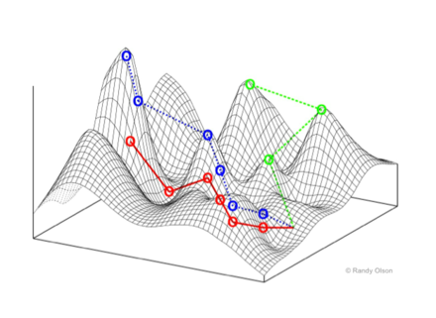
Generation as Optimization Problem
Search heuristic becomes important.
If time bound: time to create, execute, and evaluate.
If attempt bound: strategy used to choose next solution.
Ignoring bad solutions, learning what makes a solution good.
In practice, efficiency in both categories is desired.
Notes:
If you have a Search for the best solution possible given the search budget then (2). If you are bound to a period of time - 2 minutes and we’re done - the time to create, execute, and evaluate solutions is incredibly important. If you are attempt-bound - make a thousand guesses and you’re done - how you choose your next solution, how you discard solutions that you know will be bad, how you incorporate feedback, how you learn what a good solution is - those are all very important factors. In practice, you want to be efficient at both of those, but your priorities might be steered by how you define search budget. Many search strategies are possible.

Slide 12
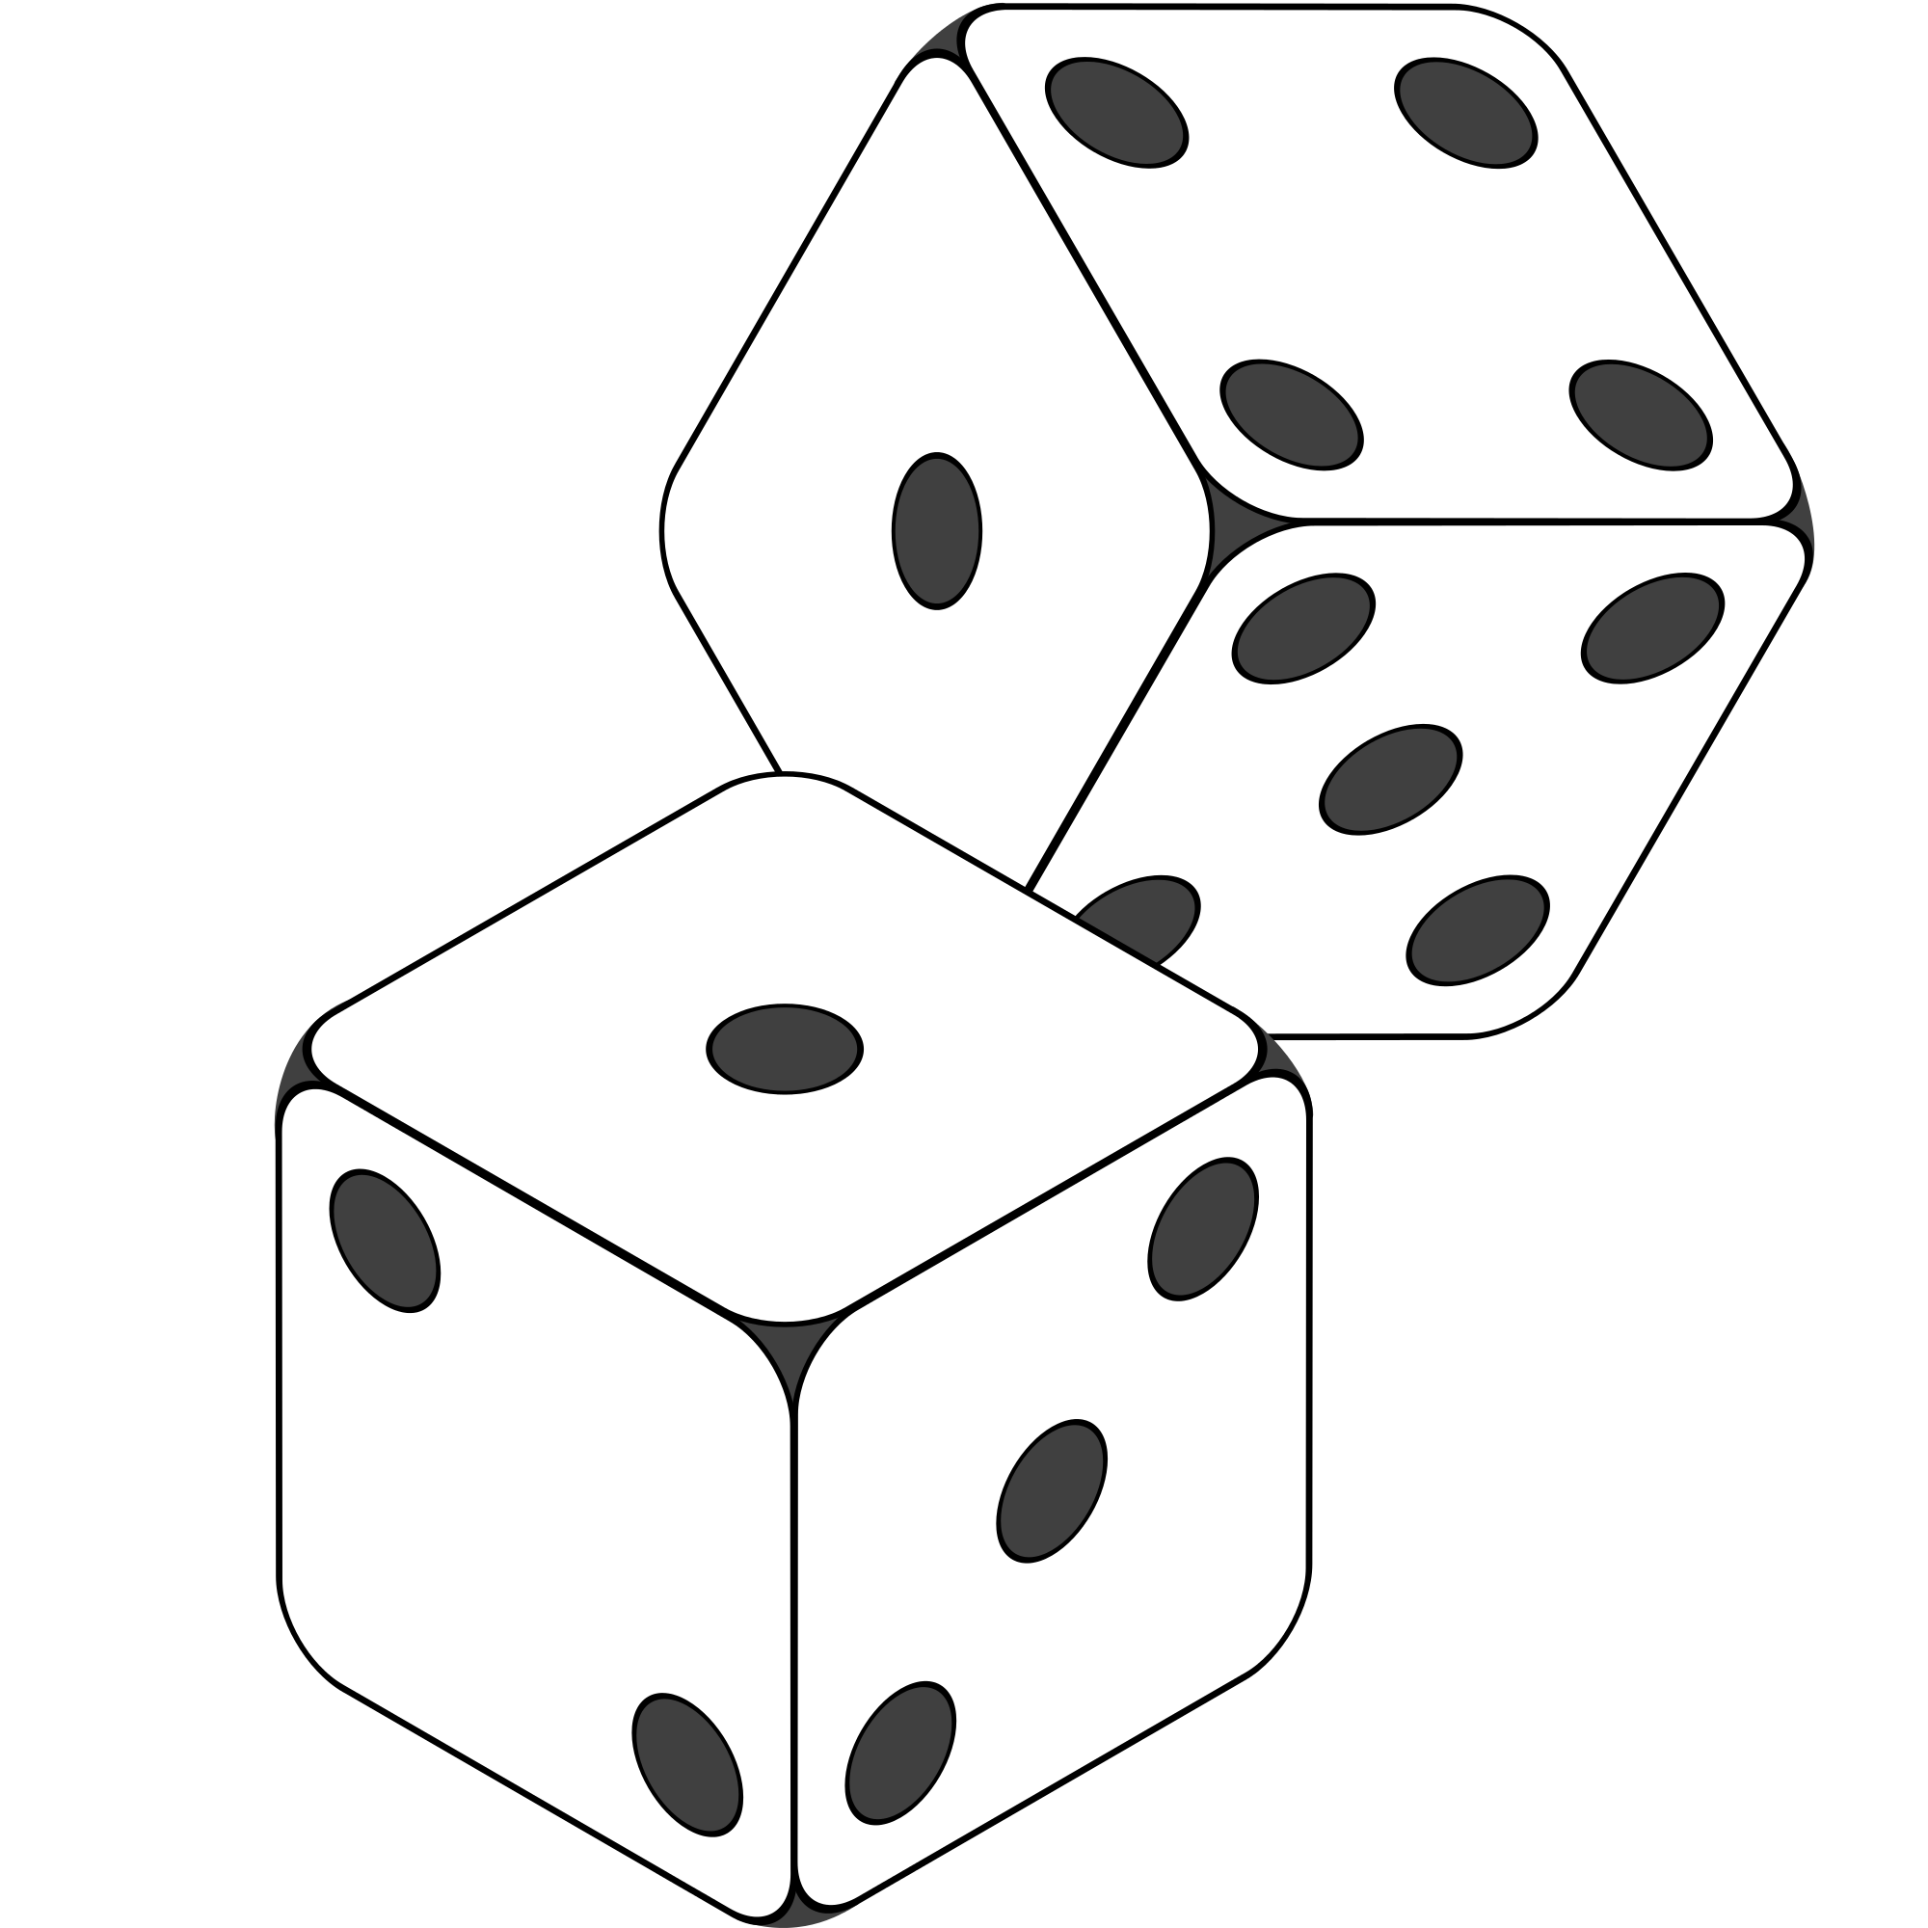
Random Search
Randomly formulate a solution.
Unit testing: choose a class in the system, choose random methods, call with random parameter values.
System-level testing: choose an interface, choose random functions from interface, call with random values.
Keep trying until goal attained or budget expires.
Notes:
The simplest thing you can do is a random search. (1) If we’re unit testing, choose a class in the system. Generate a series of method calls to that class. Random number of calls, range 1-(max test case size). Methods to call chosen randomly from list of methods. Method parameters generated randomly. Random integer, random string, etc. Run those tests, see if they meet your goals. If system-level tests, we’re looking at a similar strategy. Generate a series of calls to an API, CLI, or GUI up to a set max test size. Set the parameters of those randomly. Run them and see what happens. You get the point. Generate a set of test cases completely at random, try them
If it doesn’t work, try another solution. Keep trying until the goal is attained or budget expires.Pretty straightforward.

Slide 13
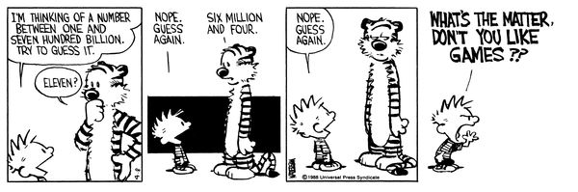
Random Search
Sometime viable:
Extremely fast.
Easy to implement, easy to understand.
All inputs considered equal, so no designer bias.
However…
Notes:
Random search is actually a somewhat common method of coming up with test inputs. (1) There is no overhead, no complex planning, just pick and try. Nothing beats it on pure speed per guess. It’s easy to understand, easy to implement. All inputs considered equal, so no designer bias. It is absolutely a viable method of testing some systems, especially if you’re just looking for crashes - just spam that system with input. Cram data into that interface. If you can try 10000 things in 5 minutes, you might stumble on a fault. However… (comic)

Slide 14
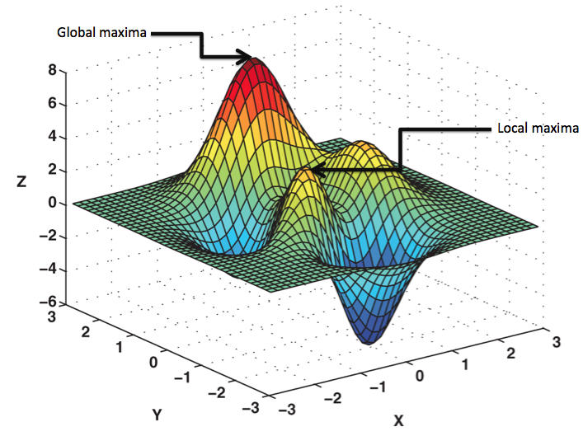
Metaheuristic Search
Random search is naive.
Only possible to cover a small % of full input space.
Metaheuristic search adds intelligence to random.
Feedback and sampling strategies.
Still fast, able to learn from bad guesses.
Notes:
The big problem with a purely random search is that the set of all possible inputs is just too huge. Random testing is way too naive a strategy for the kind of input space you see in most software. You’re basically hoping to get lucky. Even if you generate 10000 tests, you’ve only covered a tiny set of those possible inputs. As a basic idea, it’s kind of appealing and a good starting place, but it isn’t the end of the search story either. Just the start. This is where the concept of metaheuristic search comes into play. The idea of a metaheursitic search is to be somewhat random, random in a controlled manner. The idea is that we can still be fast, still try a lot of things, but learn from our attempts. Make semi-random guesses in a controlled manner, using feedback and a set of rules on how we reformulate our solutions to walk that input space in a structured manner that will, ideally, converge rapidly on a good - near-optimal if not outright optimal - solution.

Slide 15
Metaheuristic Search

Slide 16
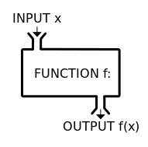

Mechanics of Optimization
AKA: How can I get a computer to search?
Metaheuristic
Fitness Function(s)
Notes:
This process is powered by what we call metaheuristic optimization algorithms. This family of algorithms centers around a very broad core idea - (1). Locating what you want depends on two key concepts,
The metaheuristic itself: An algorithmic mechanism that is responsible for proposing new solutions based on some strategy for stepping through the possible space of solutions. The metaheuristic is largely guided by feedback from one or more fintess functions. A scoring mechanism that tells you good a proposed solution is. How close is it to meeting our goals?
The metaheuristic takes feedback from the fitness functions and proposes new solutions, inching ever closer to optimality

Slide 17

Search-Based Test Generation
+
=
The Metaheuristic
(Sampling Strategy)
Genetic Algorithm
Simulated Annealing
Hill Climber
(...)
The Fitness Functions
(Feedback Strategies)
Distance to Coverage Goals
Count of Executions Thrown
Input or Output Diversity
(...)
(Goals)
Cause Crashes
Cover Code Structure, Generate Covering Array,
(...)
Notes:
Here is our equation for success. Testing has one of more goals, such as executing certain code elelements, driving the system to throw exceptions, detecting planted faults. This process, then, should yield test suites that satisfy these goals. The metaheuristic- the algorithm - and the fitness functions combine to yield these tests. The algorithm is responsible for population evolution, as guided by the fitness functions. The fitness functions offers a strategies that shape the test suites, ideally in a way that brings us closer to our goal. These are the three pieces of the equation that we can manipulate - algorithm, strategies, and goals. Let’s talk more about each

Slide 18
The Metaheuristic
Decides how to select and revise solutions.
Changes approach based on past guesses.
Fitness functions give feedback.
Population mechanisms choose new solutions and determine how solutions evolve.
Notes:
Exhaustive testing is generally impossible. There are just too many combinations of input values. So, we can’t search the whole input space. Instead We need to choose a smart strategy to sample from the search space. Not purely random - we will never find the best solution! - need something smarter. The metaheuristic decides how to select and revise solutions and Changes its approach based on past guesses by trying to learn something about what we just tried. The metaheuristic makes a purely random guess on the first attempt, then gets feedback from the fitness functions - often not just whether or not it was a good test, but how close it was to being the best test. The algorithm and fitness function form a symbiotic relationship where the algorithm tries a solution, finds out whether it meets our goals, then uses its score in conjunction with a set of population manipulation mechanisms to generate new solutions and iterate on the best solutions.

Slide 19
The Metaheuristic
Decides how to select and revise solutions.
Small adjustments (local search) or sampling from the whole space (global search).
One solution at a time or entire populations.
Often based on natural phenomena (swarm behavior, evolution).
Trade-off between speed, complexity, and understandability.
Notes:
There are millions of solutions to any problem. The job of the metaheuristic is to (1) There are two main families of metaheuristics, local searches - which revise solutions by making small adjustments to one or more current solutions- exploring the local neighborhood of the current solutions - what happens if we make a small change. Others freely sample from the whole space of possible solutions - global searches. Rather than making small adjustments, they may wildly jump around different areas of the input space. Similarly, Metaheuristics can focus on one solution at a time, or evolve entire populations. The core strategies used by many of these are based on (4). In any case, the choice of metaheuristic is a (5). Some are very fast, but vulnerable to getting trapped when a bad guess is made. Some are better for certain problems. Some are very complex and will give you a better solution, but require a substantial time investment. There are a number of trade-offs to consider.

Slide 20
“Solutions”
What is a solution?
Test Case: Evolved in isolation from other test cases.
Test Suite: A set of test cases, evolved together.
Depends on how goal attainment measured.
Code Coverage
Test Case: Target one code section at a time.
Test Suite: Target coverage of entire class/system.
Notes:
I keep saying words like “solutionS” or “guesses”. Metaheuristics evolve a population of solutions. What does that mean in test generation? It can mean one Test Case, evolved in isolation from other test cases. It can also be a whole test suite. A set of test cases, evolved together. It can also be other, problem-specific forms. For example, in combinatorial interation testing, we evolve that covering array - that set of abstract test specifications. In that case, the solution is a set of test specifications. Often ,the form you choose depends on how you measure goal attainment. For example, if our goal is code coverage, we can use either a test case or a test suite Test Case: Target one code section at a time, look for test that covers that section. Test Suite: Target maximum coverage of entire code under test and measure how much code is covered by the full suite rather than worrying about the specific test cases in that suite.

Slide 21
Local Search
Generate and score a potential solution.
Attempt to improve by looking at its neighborhood.
Make small, incremental improvements.
Very fast, efficient if good initial guess.
Get “stuck” if bad guess.
Often include reset strategies.
Notes:
Search-based generation can get quite complex, but is often more simple than you’d expect. There are dozens of metaheuristic techniques out there, but at a high level, they can be broken into two families - local and global searches. Local searches are pretty simple (1). In local search, this is generally one solution at a time, while in globalb searches, we often evolve a population of solutions in parallel. Then, (2). The neighbors are any test cases that could be generated by making a small change to the current solution- the current test case or suite. The idea is that, if you’re pretty good already, you might improve by making a tiny, tiny change. If you do, try to improve again, and keep going until you can’t get any better. Now, there are more complex methods, butlocal searches tend to be very easy to implement and are very fast to execute as long as you picked a good starting point. That’s the big issue, though. If you didn’t make a good duess, you can get stuck in a particular region of the solution space, unable to find a good solution. The basic thing that you can do to help with this is to add restarts when you get stuck.

Slide 22
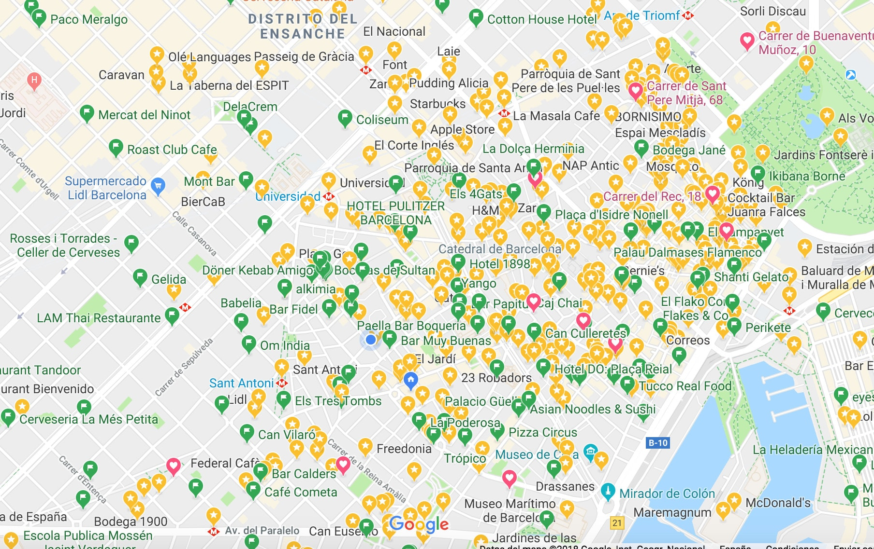
Exploring the Neighborhood
Small changes to solution.
For each call:
Switch value of boolean, other values from an enumerated set, bounded range of numeric choices.
Full test case:
Insert a new call.
Delete or replace an existing call.
Can replace by changing the function called or its parameters.
Notes:
The “neighbors” of the current test are tests that could be created by making a small change to the current test. There is some variation in how you encode a population member when generating software tests, but if we consider unit testing, we have one or more method calls made in a test case. We can either manipulate a single method call- for each call, you have a set of input variables that you assign values to. Now, what happens if we change one of those values? In this case, your choices depend on the data type - like flipping a boolean, or adding or subtracting from an integer or changing a string, adding letters, removing letters - generally, you have rules in place governing what counts as a neighbor that bound the size of the local neighborhood - the full set of possible neighbors - at any given point. These determine how big of a change you can make.
Then, on the level of a full test case (rest)

Slide 23
Hill Climbing
Pick a initial solution at random.
Examine the local neighborhood.
Choose the best neighbor and “move” to it.
Repeat until no better solution can be found.
Climbs mountains in fitness function landscape.
Restart when no improvement can be found.
Notes:
The basic form of local search is called hill climbing. The idea is basically what we went over on the last couple slides (1-3). This is called hill climbing because (4). the peaks - the stopping points - represent solutions with localized maximum values, just as the lowest levels represent solutions to avoid in the local landscape. So, you find those peaks and run at them, stopping when you can’t climb any more. If time is left, you restart and try again. At the end, you return the best solution you saw during that run.

Slide 24
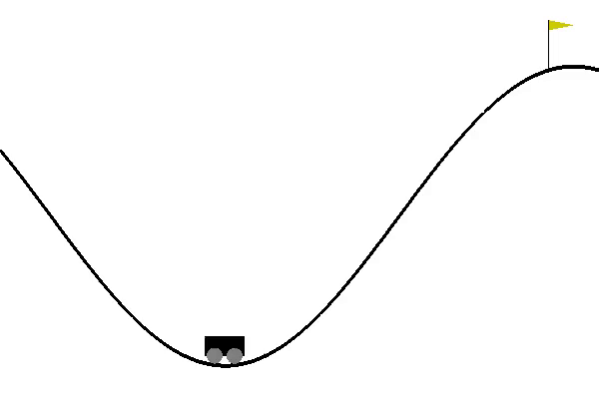
Hill Climbing Strategies
Steepest Ascent
Examine all neighbors
Pick one with highest improvement.
Random Ascent
Examine random neighbors.
Choose first to show any improvement.
Notes:
Hill climbers are often implemented in one of two ways. The first is called steepest ascent. Here, we Examine all neighbors, take the one with the highest improvement. This means it is important to limit the size of the neighborhood - impose strict rules on how big of a change you can make at one time. second is random ascent. Examine neighbors at random, and choose the first to show any improvement. The second may be preferred if you have a large number of neighboring solutions - a large number of small changes you could make to the current solution - and it doesn’t make sense to limit it further. Random ascent will be much faster in many cases.

Slide 25
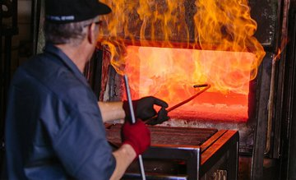
Simulated Annealing
Choose a neighboring test case.
If better, select it. If not, select it at probability: prob(score, newScore, time, temp) = e((score - newScore) * (time / temp))
Governed by temperature function: temp(time, maxTime) = (maxTime - time) / maxTime
Initially, large jumps around search space.
Stabilizes over time.
Notes:
Simulated Annealing is probably the most well-known form of local search. It’s name comes from a metallurgy technique, annealing. where a material is heated, then cooled. The heat causes the atoms in the material to wander randomly through different energy states and the cooling process increases the chances of finding a state with a lower energy than the starting position. Simulated annealing models this process as a search algorithm.
During each round, SA will choose a neighbor at random.You will then score that neighbor. If the neighbor has a better score, SA will move to it and set it as the current state. The twist on random ascent, which I mentioned in the last slide, is that If that random neighbor isn’t better - same or worse - the algorithm might move to it anyway, it will decide whether or not to move based on the probability function (2)
This probability function is guided by a temperature function that changes value over time (3). Then, like any of these approaches. We repeat until budget expires. This randomness is the very cornerstone of the Simulated Annealing algorithm. Initially, the “atoms” (current solutions) will take large random jumps, sometimes to even suboptimal new solutions. These random jumps allow simulated annealing to sample a large part of the search space, while avoiding being trapped in local minima. Eventually, the “atoms” will cool and stabilize and the search will converge to a simple hill climber. Simulated annealing is a pretty simple algoritmh that is very efficient and often delivers pretty good results. It isn’t used as often for pure test generation as the next approach we will talk about, but it’s actually the favored approach for generating covering arrays for combinatorial interaction testing.

Slide 26
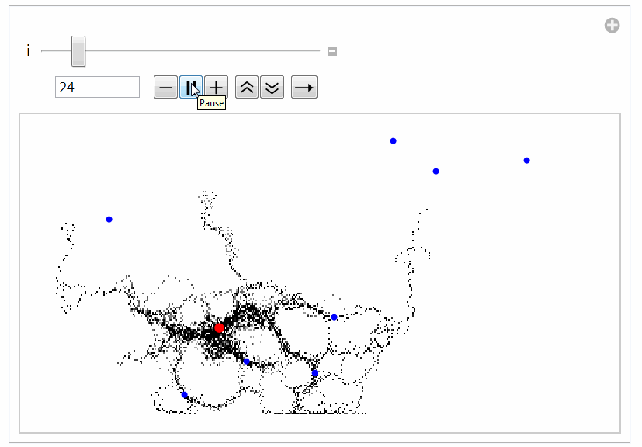
Global Search
Generate multiple solutions.
Evolve by examining whole search space.
Typically based on natural processes.
Swarm patterns, foraging behavior, evolution.
Models of how populations interact and change.
Notes:
Global searches are pretty similar conceptually, but with some major twists that change how they operate. You still form solutions, score them, then improve them. The first key difference, though, is that global searches evolve populations of solutions in parallel instead of single solutions. Then, all of the global searches have a strategy in place to sample from the whole search space instead of strictly sitting in the local neighborhood of any one solution. There are a lot of these and it is hard to generalize between them. However, they tend to be inspired by some natural process. The most famous, genetic algorithms, are based on how species evolve over time, with mechansims modeling mutation and breeding and how those influence the genepool. Particle swarm optimization looks at how swarms of insects explore a space. Ant colony optimization is based on how ants forage for food and lead other ants to food that they have discovered so it can be brought back to a hive. In general, global searches tend to (last). Let’s go over the most famous of these, and most common, the genetic algorithm

Slide 27

Genetic Algorithms
Over multiple generations, evolve a population.
Good solutions persist and reproduce.
Bad solutions are filtered out.
Diversity is introduced by:
Keeping the best solutions.
Some random solutions.
Creating “offspring” through mutation and crossover.
Notes:
At least in the area of software testing, the most popular global metaheuristic approach are what are known as genetic algorithms. Here, the idea is that you transform a population over time, favoring the better solutions for persistence and reproduction and filtering out bad solutions. Each generation, you build a new, diverse population by (4-end) best 10%, random 30%, mutation and crossover (30/30). Fiddle with percentages, but that is the rough idea. Create an initial random population, score it, the fittest survive, evolve, and reproduce, and the rest go away. We bring in some pure random guesses to maintain diversity, and we see what we end up with when the budget runs out. By taking some good solutions and keeping them, by introducing a few random children, by mutating some of the solutions, and by creating child sequences, we form this new population. We repeat this over and over until we run out of time, and as we go along, we keep track of the best tests we’ve seen.as generations pass, the average population member should keep getting better and better.

Slide 28
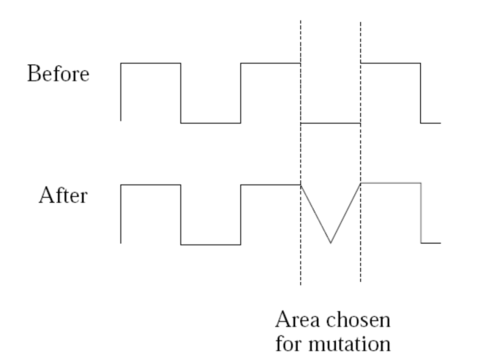
Genetic Algorithms - Mutation
Copy a high-scoring solution.
Impose a small change.
(add/delete/modify a function call, change an input value)
Follow the rules for determining the neighbors of a test.
Choose a neighbor from that set.
Notes:
In a genetic algorithm, each solution is considered to be a strand of genetic material, often explicitly modeled as a set of chromosomes that you can examine and modify - for instance, tests and its collection of function calls. So, with the mutation operator in the genetic algorithm, we take some of these high-scoring chromosome sequences - test cases or suites, copy them into a new solution, and make a small change to one chromosome of that solution - for instance, we might take an input variable and adjust its value by a small amount or insert/delete/modify a function call, adding a new call, removing a call, or changing which function is called. The idea is like in local search, we can potentially make a test better by making a small change to it. So, it follows the same idea in that we have limits to how much change can be made, defining the boundaries of the local neighborhood. Then, we choose a bneighbor from that set.

Slide 29
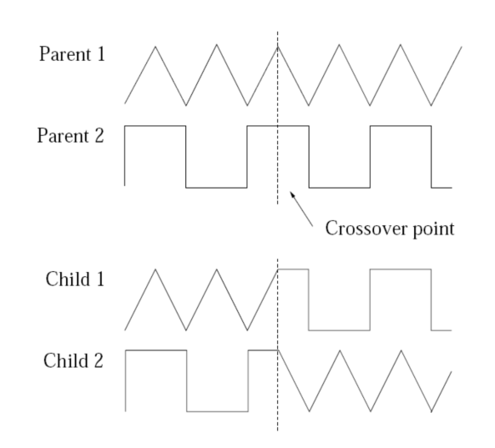
Genetic Algorithms - Crossover
By “breeding” two good tests, we may produce better tests.
Form two new solutions.
Sample from probability distribution to decide which parent to inherit from.
Notes:
The other major operator is what is known, in polite circles, as crossover. Basically, though, you make a baby test. You take two good solutions - these are our parents - the two tests fall in love and have two babies and we see if the new baby tests are better because they merge elements form theur parents. So, you pull out the chromosomes from each parent, and start flipping coins - sample from a probability function - and combine the genes of the parents - its function calls and their parameters - into two new child tests. By combining features from two good tests, we may produce better tests. We work through one line at a time from the test case. Decide whether to take a function call from parent A or B. If both make the same call, we then flip a coin on its parameters, do we take the input values from A or B. The second child gets the opposite of the first. if we draw from parent A for child A, then child B gets the element from parent B.

Slide 30
Genetic Algorithms - Crossover
One Point Crossover
Splice at crossover point.
Uniform Crossover
Flip coin at each line, second child gets other option.
Discrete Recombination
Flip coin at each line for both children.
A
B
C
D
A
B
3
4
1
2
3
4
1
2
C
D
A
B
C
D
A
2
3
D
1
2
3
4
1
B
C
4
A
B
C
D
A
2
C
4
1
2
3
4
A
B
3
4
Notes:
There are three common forms of crossover. The first is one-point crossover - splicing the chromosomes at a randomly chosen crossover point. We choose a random value from 1-length of the solution, then, we create two children. One has the elements from before that index from the first parent, then the elements after that number from the second parent. The second flips the parents.
Uniform crossover is less rigid, each line is a potential crossover point. For each line, we flip a coin. Heads, it gets the first parent’s line, tails, the second. The other child gets the remaining one.
In uniform crossover, each gene, each line, from each parent will always be copied into exactly one offspring. Discrete Recombination is a little different.
In DR, a gene may instead be copied into both children or neither with an equal probability. For both children, we flip that coin. Not just for the first child.

Slide 31
Let’s take a break.
Notes:
10 minute break

Slide 32
Fitness Functions
Domain-based scoring functions that determine how good a potential solution is.
Should offer feedback:
Percentage of goal attained.
Better - information on how to improve solution.
Can optimize more than one at once.
Independently optimize functions
Combine into single score.
Notes:
The fitness function is crucial in building an optimization algorithm. The fitness function is a Domain-based scoring functions that determine how good a potential solution is. Given a potential solution - how close is it to what we are looking for? There are often many potential fitness functions for any problem, and it is crucial to craft the correct one. It must be machine measurable, and must be efficient to calculate, as you will typically check scores thousands to millions of times per trial. Functions can then be either minimized or maximized. That is, we either try to get the highest or lowest score we can, depending on what we consider optimal. For example, we might try to maximize number of crashes or minimize the size of the covering array. Functions should offer feedback to help guide the search. Often, we measure how close we are to completing our goal. That is, we attained 75% of the checklist. That’s OK, that give us a lot of information to improve solutions. Even better, however, are fitness functions that give us something to work with, they suggest a distance from optimality or some other information on how to get a better solution, if we just changed things a little bit. What if we had two solutions that were 75% complete, but one was better for obtaining that last 25%- we should take that one. So, the best fitness functions tell us how to do that. You can optimize multiple fitness functions at once. If so, all functions will shape the final test suite, so this is often a nice way to get versatile, multifaceted tests. Now, optimizing multiple functions can be hard because they may have competing goals. Increasing one may decrease the second. So, we can optimize multiple fintness functions in two ways. we can either try to balance all - possibly competing objectives, along what we call the pareto frontier, finding solutions that improve all scores for all functions as much as possible without hurting the other functions. This is very effective, but can be very difficutl. The second thing is that we can create a single meta score as a linear combination of scores of the individual functions. This is easier and often works well, but allows maximization of one function at the expense of others.

Slide 33
Example - Branch Coverage
Goal: Attain Branch Coverage over the code.
Tests reach branching point (i.e., if-statement) and execute all possible outcomes.
Fitness function (Attempt 1):
Measure coverage and try to maximize % covered.
Good: Measurable indicator of progress.
Bad: No information on how to improve coverage.
Notes:
So, to give an example, let’s take branch coverage. This is a structural coverage measurement, used to determine how good your tests are. When we measure branch coverage, we look at the decision points in a program - if statements, loop statements - for, while, foreach, etc, switch statements, and ensure that we try the different outcomes - true and false for if-statements and loop conditions, the different cases for a switch. The idea is that tests that cover the different outcomes of these statements will do a good job of thoroughly touching each line of code, making those tests more likely to expose bugs. This is often used to decide when you’re done testing - did you cover every branch outcome? This is a good goal for test generation, as we can measure it without a human present. This means we can try to optimize it. Now, how would you design a fitness function for it. Well, as a first attempt, we could just measure coverage and try to maximize that percentage. However, this is not an ideal fitness function. Does not do much to inform the search process on how to improve solutions. We can tell how good any one solution is, but have to way to compare two solutions with equal coverage to see which could be improved more easily. Instead - what we want to know is whether we can we score a test such that we can learn from the attempt? Not just “is this good”, but “how close is this to being THE BEST”

Slide 34
Example - Branch Coverage
Attempt 2: Distance-Based Function
fitness = branch distance + approach level
Approach level
Number of branching points we need to execute to get to the target branching point.
Branch distance
If other outcome is taken, how “close” was the target outcome?
How much do we need to change program values to get the outcome we wanted?
Notes:
So, generally, we don’t directly use branch coverage as the fitness function. Instead, a common fitness function for branch coverage is to target a single branch and outcome at a time, execute a test, and calculate two things - called the branch distance and approach level. The approach level is defined as the count of the target branch's control-dependent predecessors that have not been executed---that means the earlier branches in the code that we need to pass through to get to this point - how many if-statements, loops statements, and switches need to execute in the manner we desire to get to THIS branch. It is essentially a directional indicator. It gets lower as the execution path gets closer to the target branch.
now, if we reach the right line of code where the target branch exists, but get the wrong outcome - say true when we wanted false - the branch distance kicks in. Branch distance is computed from the point where the execution path diverged from the targeted branch. If an undesired outcome is taken, branch distance describes how ``close'' we were to the outcome we wanted, using a cost function based on the formula of that statement. (last point) Let’s look at an example of this.

Slide 35
Example - Branch Coverage
if(x < 10){ // Branch 1
// Do something.
}else if (x == 10){ // Branch 2
// Do something else.
}
Approach Level
If Branch 1 is true, approach level = 1
If Branch 1 is false, approach level = 0
Branch Distance
If x==10 evaluates to false, branch distance = (abs(x-10)+k).
Closer x is to 10, closer the branch distance.
Goal: Branch 2, True Outcome
Notes:
Suppose that the current goal is to execute the \texttt{true} outcome of branching point 2. If branching point 1 is reached and evaluates to \texttt{true}, then the approach level is 1. We are one branching point away from our target. If, instead, \texttt{x == 10} - branching point 2 - is reached, then the approach level is 0, as the target branching point has been reached. If \texttt{x == 10} evaluates to \texttt{false}, then we didn’t get the outcome we wanted. In that case, we check branch distance using the formula \texttt{abs(x-10) + k}, where k is a small constant. The closer \texttt{x} is to 10, the closer the targeted outcome was to being hit. We get the exact formula based on the contents of the if-statement, but the general idea is the same. this gives us some information to work with. We know how close a test is to giving the outcome we wanted, and this arms the search with the ability to get a little bit closer each time to hitting that outcome. If two solutions give us the same total branch coverage, we can favor the one that gets us closer to covering the remaining branches - that have the smallest approach level and branch distance.

Slide 36
Other Common Fitness Functions
Number of methods called by test suite
Number of crashes or exceptions thrown
Diversity of input or output
Detection of planted faults
Amount of energy consumed
Amount of data downloaded/uploaded
… (anything that reflects what a good test is)
Notes:
(go over). Great thing is the flexibility of this method. Fitness functions shape a test suite, based on what you feel is a good test suite. Anything that can be measured efficiently can be used as a fitness function. And, you often choose a couple of these and try to optimize them all at once, shaping an effective test suite.

Slide 37
What are your testing goals?
(and would they make good fitness functions?)
Notes:
You just have to ask and think about (slide)

Slide 38

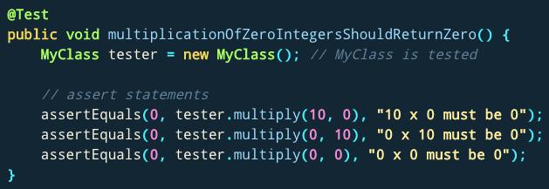
What Do I Do With These Inputs?
If looking for crashes, just run generated input.
If you need to judge correctness, add assertions.
General properties, not specific output.
No: assertEquals(output, 2)
Yes: assertTrue(output % 2 == 0)
Notes:
(title) If you’re just looking for crashes or exceptions, you’re done! run them, see if something breaks.this is generally what you do in fuzzing. The fuzzer maximizes some fitness functions, often based on code coverage, generating huge quanitites of effective input. You see if something crashes, if there is a memory leak, if there is a buffer overflow, and if any of those happen, there is a problem. Now, sometime you still need something more complicated, something to judge correctness if the test passes. In those cases, you need to add assertions still. Good advice here is not to develop assertions that check for exact values. Instead, if you develop assertions as universal properties (not specific output expected), can apply those to all tests. So, rather than an assertion that says that the outcome if 4 if the input is 2, instead, an assertion that the outcome will be a positive, even number. Something that can be applied either universally or across a wide range of test input.

Slide 39
Generating Covering Arrays for Combinatorial Interaction Testing
Notes:
disclaimer- this will be a heavily simplified approach - we aren’t handling constraints, this will not be the most efficient, however, I just want to give a good basic example of how you would start to solve this problem. domn’t expect to win speed awards with this or handle complex problems, but this will help illustrate a search-based approach

Slide 40
CIT
Allow Content to Load | Notify About Pop-Ups | Allow Cookies | Warn About Add-Ons | Warn About Attack Sites | Warn About Forgeries
Allow | Yes | Allow | Yes | Yes | Yes
Restrict | No | Restrict | No | No | No
Block |  | Block
Instead of testing all combinations, test all 2-way interactions.
Covering Array: A set of test specifications that covers all pairs of values.
From 144 specifications to 9
Generating smallest covering array NP-hard.
Metaheuristic search can easily generate near-smallest covering array.
Allow Content | Allow Cookies
Allow | Allow
Allow | Restrict
Allow | Block
Restrict | Allow
Restrict | Restrict
Restrict | Block
Block | Allow
Block | Restrict
Block | Block
Pop-Ups
Yes
No
No
Yes
Yes
No
No
-
Yes
Add-Ons
Yes
No
No
No
-
Yes
-
Yes
No
Attacks
Yes
-
No
No
-
Yes
-
No
Yes
Forgeries
Yes
No
Yes
No
Yes
No
Yes
-
No
Notes:
Last class, we discussed combinatorial interaction testing. Here, we have a set of decisions we make when testing - inputs, options we choose for variation points, and other factors we control when we perform system-level testing of a high-level function of the system. For each choice, we have a set of values we can select from. We form test specifications, abstract descriptions of test cases, by choosing a value for each choice. Covering all combinations of choices results in a huge number of test specifications, but we can cover a reasonable portion by focusing on interaction between two or more features. If we cover all 2-way interactions, all pairs of values for the set of choices, we will likely cover the majority of interactions that could go wrong. So, the goal of combinatorial interaction testing is to create a covering array - a small set of test specifications that covers all 2-way interactions. In the case here, we go from 144 total specifications to 9 that cover all 2-way interactions. We may not see all faults we would from the 144 set, but we would likely see most interaction faults for a tiny fraction of the cost. Now, this particular case isn’t too hard to come up with by hand. However, for many complex systems, we have not 144 combinations from 6 variables, but hundreds of thousands of combinations from dozens of variables. This is hard to come up with by hand. Worse, a human might not come up with the smallest covering array, especially as the problem gets harder. It’s easy to come up with A covering array. Coming up with the smallest covering array is an NP hard problem. However, we can use metaheuristic search to come up with a near-optimal covering array quite easily for massive problems that no human could easily solve.

Slide 41
Generating Covering Arrays
Generating Random Solutions
Calculating Solution Fitness
Evolving Solutions
Mutation (Genetic Algorithm) / Neighboring Solution (Local Search)
Crossover (Genetic Algorithm)
Notes:
So, let’s look at how we would generate covering arrays using metaheuristic search. In particular, we need to look at three aspects of this. (go over)

Slide 42
Generating Random Solution
Calculate list of pairs to cover.
Until list is empty:
Generate random test specification.
Remove covered pairs from list.
Add specification to covering array.
Return covering array.
(Content = Allow, Pop-Ups = Yes)
(Content = Allow, Pop-Ups = No)
(Content = Restrict, Pop-Ups = Yes)
…
Allow | No | Block | No | Yes | Yes
(Content = Allow, Pop-Ups = Yes)
(Content = Allow, Pop-Ups = No)
(Content = Restrict, Pop-Ups = Yes)
…
.. | .. | .. | .. | .. | ..
Allow | No | Block | No | Yes | Yes
Notes:
The first thing we do, regardless of the search algorithm employed, is that we generate solutions at random. In a local search - hill climber or simulated annealing - we would then try to improve that random solution, possibly restarting with a brand new random solution if we can’t improve the current one any further. Throughout the process, if we use a genetic algorithm, we will also generate new random solutions to diversify the population. So, how do we generate a random covering array. This is not too hard. (click) First, we calculate the list of all pairs that need to be covered. (click) Then, We just start a new test specification and pick a value for each choice at random. (click) Then, we check off the additional pairs from this list that have been covered. (click) We add that specification to the covering array. We check and see if there are remaining items in that list - have we covered all pairs of representative values? IF not, we start a new test specification, and we pick values at random again. We check off additional pairs, we check whether all pairs are covered. If not, try again. Keep going until your set of test specificaitons has covered all pairs of values. If this the bestpossible way to do this? Not quite, we have learned a lot of tricks to make this more efficient. However, this is a good enough starting point. Many of these covering arrays will be much larger than necessary. However, that is where the elements of a metaheuristic search algorithm kick in. The fitness function indicates which covering arrays are smallest, and the heuristic works to improve these initially random solutions.

Slide 43
Fitness Function
Size of the covering array.
coveringArray.length();
Want to minimize the score (smaller arrays are better)
Can be measured, fast calculation.
Tells us which solutions are better.
Does not offer detailed feedback, but still works.
..
..
..
..
..
..
..
..
..
Notes:
The fitness function for this problem is pretty simple. It is just the size of the covering array, we can just call array.length on this. This is a function we want to minimize. We want small covering arrays. So, better solutions are smaller. We want to track the smallest solutions seen. Now, this is not one of these complex, distance-based feedback granting fitness functions. It doesn’t really tell us how to make a covering array smaller. However, this is also a problem that doesn’t lend itself well to that kind of complex fitness function. The length does meet the basic criteria, however, it can be calculated and measured by software, it is efficient to calculate, it differentiate two solutions, and gives us an indication of progress - as long as the metaheuristic works correctly, we should see smaller and smaller arrays surface to the top over time.

Slide 44
Mutation
Change a value in a test specification.
Set a limit on number of changes made at one time.
Maybe we can make it smaller with a few changes?
If all pairs covered in fewer tests, discard remainder.
If no longer a covering array:
Throw out solution OR
Revert change and try again OR
Revert change and mutate different solution.
Notes:
A genetic algorithm manipulates solutions in two ways. First is mutation, where we make a small change to a solution. This is the same idea as the local neighborhood in a local search, hill climber or simulated annealing, where you look at the potential neighbors of the current solution - the new solutions created by making a small change to one solution - and see if anything in that neighborhood is better. So, to mutate a covering array, what kind of change could you make? Well, the obvious one that stands out is that you can take one or more test specifications and change the value picked for a choice. Now, you can check that covering array. If it is still a covering array, we keep it. If it can be smaller now, we discard any extra test specifications. If it is the same size, that’s fine too, we keep it - maybe additional changes later will make it even smaller. If it is no longer a covering array after the change, we could choose to (1) throw it out, (2) revert the change and try again, (3) pick a different solution and try to mutate it. Eventually, we will have covering arrays so small we can’t make changes to them, so you want to eventually give up if you find you can’t make it smaller after a set number of tries.

Slide 45
Crossover
Take two covering arrays, create two “child” arrays.
For each specification, flip a coin:
Heads:
Tails:
Check each child:
If not a covering array, discard.
If still a covering array, remove redundant specifications.
Parent A
Parent B
Parent A
Parent B
Child A
Child B
Child A
Child B
Notes:
The second main mechansim of a genetic algorithm for evolving a population is the idea of crossover. The idea that we can take two solutions and breed elements of each together to make an even better solution. How do we do that with two solutions for this problem? What we want to do is take two solutions - two covering arrays - and start flipping a coin for each test specification in each. Heads, child A gets a specification from parent A and child B gets a specification from parent B, tails, Child b gets a specfication from parent A and child A gets one from parent B. We do this for every specification. If the number of specifications is not the same, the flip is between getting one specification added or none. Now, once we form children, we need to do two things. 1) See if it is still a covering array. If not, we throw that child out. 2) If it is a covering array, see if we can shrink it. Step through each specification, cross off the covered pairs, stop when all pairs are covered. If there are remaining specifications, throw them out. Add the newly created, smaller covering array to the population of solutions.

Slide 46
Search Process
Generate population at random.
Score each by size.
Create new population.
Retain best arrays (10%)
Create mutations (30%)
Create children (30%)
Generate random (30%)
Repeat until budget expires.
Notes:
Let’s tie this together. IF we want to use a genetic algorithm to generate covering arrays, we do the following. 1) Generate a population of random covering arrays. 2) Score them using the fitness function. 3) Create a new generation. We do this by taking the best solutions, maybe 10% and moving them over to the new population unchanged. Then, we use those 10% to create mutated copies. We fill maybe 30% of the population with mutated covering arrays. Next, we take those 10% best and breed them through crossover to create new covering arrays. Again, maybe 30% of the population should be filled with these baby covering arrays. We still have 30% of the population left. For those, we generate a bunch of additional completely random arrays. This starts our evolutionary process. Now, until we run out of search budget, we will score the population and use those scores to guide the creation of a new population, retaining some of the best solutions, mutating some, performing crossover to get new solutions, and generating random solutions. Over time, as we do this, the average population member should get smaller and smaller, until at the end, we return the smallest valid covering array we find. This can be done efficiently, in far less time than it would take a human, and will often return better solutions than a human would ever be able to create.
Any questions?

Slide 47
Not Just Test Generation...
Can be applied to any problem with:
Large search space.
Fitness function and solution generation with low computational complexity.
Approximate continuity in fitness function scoring.
No known optimal solution.
Notes:
Now, it’s not all about just test generation. That’s just one of the things we’re learning how to automate. Metaheuristic search can be applied to any problem where the following four conditions are met:
• A Large Search Space: If there are only a small number of factors to compare, there is no need for a meta-heuristic approach. This is rarely the case, as software engineering typically deals in incredibly large search spaces (i.e. the space of all expressible programs written in the JAVA language).
• Low Computational Complexity: If the first property is met, SBSE algorithms must sample a non-trivial population. A typical run of one of these searches requires thousands of executions of a fitness evaluation. So, the computational complexity of both the fitness function and your solution generator have a major impact on the overall search.
• Approximate Continuity: While it is not necessary for the fitness function to be continuous, too much discontinuity can mislead a search. So, if you take a solution and make a small change to it, the fitness evaluation should be pretty close. Maybe a little better or a little worse, but close. Any search-based optimization must rely on an objective function for guidance, and some level of continuity will ensure that that guidance is accurate.
• No Known Optimal Solutions: If an optimal solution to a problem is already known, then there’s no point in searching for it.
So, there are actually a pretty huge number of SE problems that fit this mold. These techniques are being used to power patch generation, porting of code features to new systems, automated refactoring, and to help solve a number of other problems.

Slide 48
Automated Program Repair
Produce patches for common bug types.
Many bugs can be fixed with just a few changes to the source code - inserting new code, and deleting or moving existing code.
Add null values check.
Change conditional expression.
Move a line within a try-catch block.
Notes:
Unfortunately, the number of reported bugs far outstrips available development resources. It is common for a popular project to have hundreds of new bug reports filed every day. What would you do? How can you keep up? Currently, the answer is “not well”. So, what do we do about that?
automated program Repair techniques, like GenProg, a collaboration between researchers at CMU and UVA, automatically produce patches that can repair common bug types. The idea is that Many bugs can be fixed with just a few changes to a program's source code. Human repairs often involve inserting new code and deleting or moving existing code. GenProg uses those same building blocks to search for repairs automatically. It can make sequences of small edits to the source code, based on common change types. This might include deleting a line of code, adding a check for null values to fix null pointer errors, flipping a < to a >, or other patterns that can avert certain types of bugs. We use these common code edits to try to automatically produce a patch that fixes the code.

Slide 49
Generate and Validate
Genetic programming - solutions represent sequences of edits to the source code.
Generate and validate approach:
Fitness function: how many tests pass?
Patches that pass more tests create new population:
Mutation: Change one edit into another.
Crossover: Merge edits from two parent patches.
Notes:
GenProg usesa process called genetic programming to search for repairs. Our evolutionary computation represents candidate repairs as sequences of edits to software source code. Each candidate in a large population is applied to the original program to produce a new program, which is evaluated using test suites. Those candidates that pass more tests and have a smaller size are said to have a higher fitness and are iteratively subjected to computational analogs of the biological processes of mutation and crossover to produce additional patches where we either mutate an edit into another edit or we combine edits from parent patches. This process terminates when a candidate repair is found that retains all required functionality and fixes the bug.

Slide 50
GenProg Results
Repaired 55/105 bugs at average $8 per bug.
Projects with over 5 million lines of code
Supported by 10000 test cases.
Patch infinite loops, segmentation faults, buffer overflows, denial of service vulnerabilities, “wrong output” faults, and more.
Notes:
In a study of multiple programs, GenProg repaired 55 out of 105 bugs for $8 each - that was the cost of the computation time on Amazon cloud computing servers. The projects studied were pretty large too, totaling over 5 million lines of code, and supported by over 10,000 test cases.
The bugs repaired include many kinds of defects, including infinite loops, segmentation violations, heap buffer overflows, denial-of-service vulnerabilities, stack buffer overflows, string vulnerabilities, integer overflows, and good old fashioned "my program produces the incorrect output" bugs. These techniques are far from fixing all bugs or even most super complicated bugs, but can handle many common, simple bug types without human intervention.

Slide 51
Risks of Automation
Structural coverage is important.
Unless we execute a statement, we’re unlikely to detect a fault in that statement.
More important: how we execute the code.
Humans incorporate context from a project.
“Context” is difficult for automation to derive.
One-size-fits-all approaches.
Notes:
There are some risks in automation in this manner. The first is that these simple metrics that we can calculate with computers, like code coverage, are important. (2) However, more important is how we execute that code, and that involves context and nuance missing in current fitness functions. The current use of things like coverage criteria in automated generation sharply contrasts how those criteria are used by humans. For a human, coverage typically serves an advisory role—as a way to point out gaps in existing efforts. Human testers build suites in which coverage criteria contribute to a toolbox of testing strategies. Humans build and vary their testing strategy based on the needs of their current target. Yet, in automated generation, code coverage might be the only goal, and a single fitness function is often applied at a time. (4-6) where we think all code can be tested in the same way, and that is simple and naive.

Slide 52
Limitations of Automation
Automation produces different tests than humans.
“shortest-path” approach to attaining coverage.
Apply input different from what humans would try.
Execute sequences of calls that a human might not try.
Automation can be very effective, but more work is needed to improve it.
Notes:
As a result, the Tests produced by current automation techniques are very different from human-written tests. they Take a “shortest-path” approach to attaining coverage - small simple tests that cover a lot of code are considered best, when a human doesn’t think that way - they write tests to make the system do interesting things, THEN check coverage to see if they are done. Tests Apply input different from what humans would try. They Execute sequences of method calls that a human might not try. Automation can be very effective, but more work is needed to improve it.

Slide 53
I Want to Try This Out!
Fuzzing often based on metaheuristic search.
AFL (American Fuzzy Lop), Google OSS-Fuzz use genetic algorithms, fitness = code coverage.
http://lcamtuf.coredump.cx/afl/
https://google.github.io/oss-fuz
system-level tests
The Fuzzing Book has tutorials and code for many specialized approaches:
https://www.fuzzingbook.org/

Slide 54
I Want to Try This Out!
EvoSuite generates JUnit tests for Java
http://www.evosuite.org/
Sapienz (Facebook) tests Android/iOS apps
Will be open-source by end of 2020 2021?.
Older version available
https://github.com/Rhapsod/sapienz/
Have a specialized goal?
NSGA-II: customizable open-source genetic algorithm: https://www.iitk.ac.in/kangal/codes.shtml

Slide 55
Summary
+
=
The Metaheuristic
(Algorithm)
Genetic Algorithm
Simulated Annealing
Hill Climber
(...)
The Fitness Functions
(Feedback Strategies)
Distance to Coverage Goals
Count of Executions Thrown
Input or Output Diversity
(...)
(Goals)
Cause Crashes
Cover Code Structure, Maximize Battery Use,
(...)
Notes:
When we create test cases, we are usually searching for tests that fulfill a goal. Such as code coverage. If we have a measurable goal, algorithms can perform a search process, automating the creation of test inputs.
Here is our equation for success algorithm + feedback strategies yields goal-meeting tests. Search-based techniques can be implemented fairly easily - though can also get quite fancy - and are very flexible. Increasingly, they are used to identify program and security flaws.

Slide 56
Next Time
Exercise Session - Mutation Testing
Will be 14:15 - 16:00 today!
Model-Based Testing and Verification
Reading: Pezze and Young, Ch 5.5, 8, 14
Assignment 2 - Due February 28
Questions?
Assignment 3 - Due March 12
Out now!
Based on Fault-Based Testing (Lec 11) and Finite State Verification (Lectures 13-14)

